Slide 1
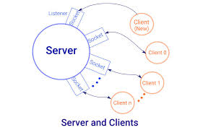
Socket Programming
The “Socket Programming” involves connecting two nodes on network to communicate with each other
Sockets allow communication between two different processes on the same or different machines
Socket is a way to talk to other computers using standard Unix/Linux file descriptors
One socket (node) listen to specific port and IP address, while other socket(node) sends data
When socket is created, the program must specify the address domain and socket type
A file descriptor is just an integer associated with an open file and it can be a network connection, a text file, a terminal, or something else
Socket is used in standard “Client-Server” architecture
Most of the application-level protocols like FTP, SMTP, and POP3 make use of sockets to establish connection between client and server and then for exchanging data

Slide 2
Socket Programming continued …
Socket Types:
There are 4 socket types available but first two are most commonly used and the last two are rarely used
Processes are presumed to communicate only between sockets of the same type but there is no restriction that prevents communication between sockets of different types
Stream Sockets
Datagram Sockets
Sequenced Packet Sockets
Raw Sockets
Uses TCP/IP for data transmission
The order of packet is guaranteed ABC will arrive in ABC
Delivery in network environment is guaranteed
Uses UDP for data transmission
Delivery in network environment is not guaranteed
Order of packet not retained
Uses UDP for data transmission
Not used in general use cases
Used in new communication req
Used for accessing cryptic info
They are similar to Stream Sockets
These sockets allows modifying header on packet or group of packet
Used NS applications

Slide 3
IP Address
The “IP Address” used for identifying host connected to network
IP stands for Internet Protocol and refers to the Internet Layer of the overall network architecture of the Internet
An IP address is a 32-bit quantity interpreted as four 8-bit numbers or octets
Each IP address uniquely identifies the participating user network
IP address is usually written in a dotted-decimal notation of the form N1.N2.N3.N4
Where N1/N2/N3/N4 values can be from 0 to 255 decimal
IP addresses are managed and created by the Internet Assigned Numbers Authority (IANA)
There are 5 categories of IP addresses
Class-A
Class-B
Class-C
Class-D
Class-E
The IP Address range begin with 0xxx, or 1 to 126 decimal
The IP Address range begin with 10xx, or 128 to 191 decimal
The IP Address range begin with 110xx, or 192 to 223 decimal
The IP Address range begin with 1110xx, or 224 to 239 decimal
The IP Address range begin with 1111xx, or 240 to 254 decimal
Addresses beginning with 01111111, or 127 decimal, are reserved for loopback and for internal testing on a local machine
Class D addresses are reserved for multicasting & Class E addresses are reserved for future use

Slide 4
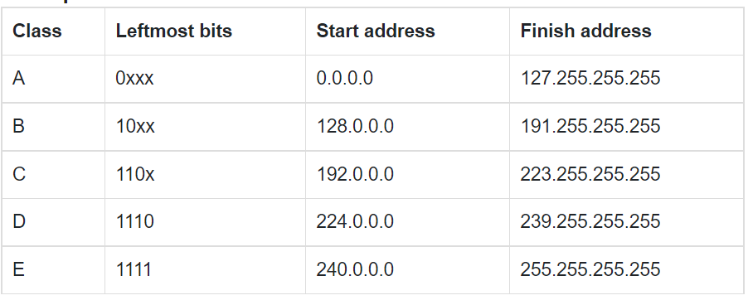
IP Address Continued…

